Slide 1

The Scrum-Agile Approach
Bryan Pirrone

Slide 2
References
Cobb, C. G. (2015). The Project Manager’s Guide to Mastering Agile: Principles and Practices for an Adaptive Approach (1st ed.). Wiley.
SDLC - Agile Model. (2013). Https://Www.Tutorialspoint.Com/. https://www.tutorialspoint.com/sdlc/sdlc_agile_model.htm

Slide 3
The Scrum-Agile Team members
Product owner
Scrum master
Development Team
User(s) (Client(s))
(Cobb, 2015)

Slide 4
Product Owner
Clearly expresses the Product Backlog items
Orders the items in the Product Backlog to achieve goals and missions
Optimizes the value of the work the Development Team performs
Ensures that the Product Backlog is visible, transparent, and clear to all, and shows what the Scrum Team will work on next
Ensures the Development Team understands the items in the Product Backlog to the level needed
(Cobb, 2015)

Slide 5
Product Owner
The Product Owner represents the business sponsor, is a decision maker for the project, provides direction to the team on what will be built, and prioritizes the work to be done.
Acts as a liaison between the customers and the development team
Owns, prioritizes, and sets expectations regarding the Product Backlog
(Cobb, 2015)

Slide 6
Scrum Master
Finds techniques for effective Product Backlog management
Helping the Scrum Team understand the need for clear and concise Product Backlog items
Understands product planning in an empirical environment
Ensures the Product Owner knows how to arrange the Product Backlog to maximize value
Understands and practices agile
Facilitates Scrum events as request or needed
Coaches the Development Team in self-organization and cross-functionality
(Cobb, 2015)

Slide 7
Scrum Master
Helps the Development Team create high-value products
Removes impediments to the Development Team’s progress
Coaches the Development Team in organizational environments in which Scrum is not yet fully adopted or understood
Leads and coaches the organization in its Scrum adoption
Plans Scrum implementation within the organization
Helps employees and stakeholders understand and enact Scrum and empirical product development
Causes change that increase the productivity of the Scrum Team
Works with other Scrum Masters to increase the effectiveness of the application of Scrum in the organization
(Cobb, 2015)

Slide 8
Scrum Master
Known in agile as a servant leader
Does not provide direction like the Product Owner
Has the responsibility to facilitate the team in all aspects
(Cobb, 2015)

Slide 9
Development Team
Single entity where all the members of the team act collaboratively and cohesively as a single unit
Consists of individuals who develop and test
Modifies user stories to fit the user(s) wants and needs
Discusses changes and deviations as they arise
Self-organizing
Charged with turning Product Backlog item(s) into increments of potentially releasable functionality
Supports cross-functionality
(Cobb, 2015)

Slide 10
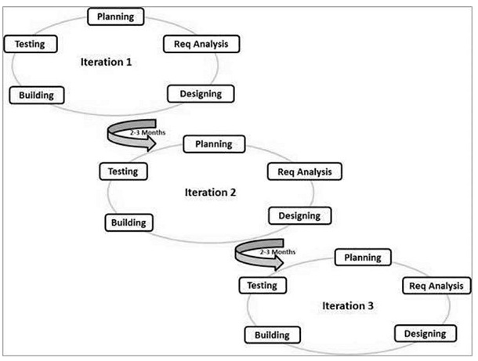
Phases of the SDLC in an Agile approach
(SDLC - Agile Model, 2013)

Slide 11
Planning
Receiving inputs from Customers, Team, Managers, Execs
Prioritized Product Backlog generated/modified
Sprint Planning Meeting
Sprint Backlog
User stories prioritized and generated
(SDLC - Agile Model, 2013)

Slide 12
Requirement Analysis
User stories analyzed for acceptance and failure criteria
Well defined user stories generated/modified
Resource allocation decisions made
Tasks assigned to individuals/teams (pair coding, etc…)
Information Radiator generated
(SDLC - Agile Model, 2013)

Slide 13
Designing
Tasks begin/continue
Daily Standup Meetings occur
Completed, in progress, and not yet started tasks tracked on Information Radiator
Backlog Items/Sprint Backlog Items tracked on Information Radiator
Impediments identified
(SDLC - Agile Model, 2013)

Slide 14
Building
Work commences
Daily standup meetings occur
Completed, in progress, and not yet started tasks tracked on Information Radiator
Backlog Items/Sprint Backlog Items tracked on Information Radiator
Impediments identified
(SDLC - Agile Model, 2013)

Slide 15
Testing
Product testing occurs
Feedback requested from user(s) on a case-by-case basis
Problems addressed and solutions identified
(SDLC - Agile Model, 2013)

Slide 16
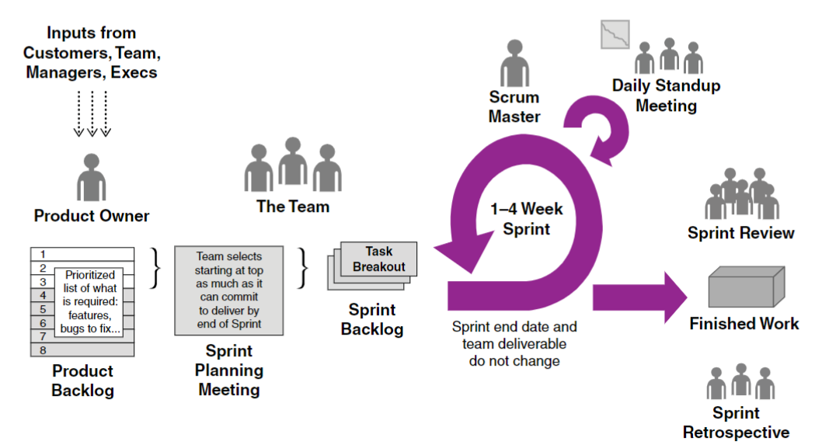
Phases of the SDLC in an Agile approach
(Cobb, 2015)

Slide 17
If we used a waterfall approach…
No useful software would have been produced until late during the lifecycle
Not suitable for projects where requirements are at a moderate to high risk of changing
Measuring progress is difficult
Cannot accommodate changing requirements
Linear phase progression
(Cobb, 2015; SDLC - Agile Model, 2013)

Slide 18
Consideration Factors
When deciding between a waterfall-based approach or an agile-based approach, several factors would need to be considered:
The size of the project
Are the milestone well understood
Are the tasks easy to arrange
Does the rigid nature of waterfall make sense for the product
Is teamwork and cross-training important
Does functionality need to be developed rapidly and demonstrated
Do we need to be flexible if attributes change
(Cobb, 2015; SDLC - Agile Model, 2013)

Slide 19
Agile Model
Due to the fluid nature of the product, an agile-based approach would be the most beneficial. Since there is a degree of change due to the nature of the product and the ability to present early partial solutions and functionality, an agile-approach seems necessary.
Chada Tech mission is to deliver first time quality products to the consumers. Only an agile methodology can ensure that we meet this mission and goal.
(Cobb, 2015; SDLC - Agile Model, 2013)

